Slide 1


Simultaneous System Identification and Model
Predictive Control with No Dynamic Regret
Hongyu Zhou, Vasileios Tzoumas

Slide 2
Robots That Learn Continuously Across Tasks & Domains
Lifelong/Continual Learning
Isolated/Self-supervised Learning
Increasing
Difficulty & Autonomy
On-the-fly/Online Adaptation
Focus of this work

Slide 3

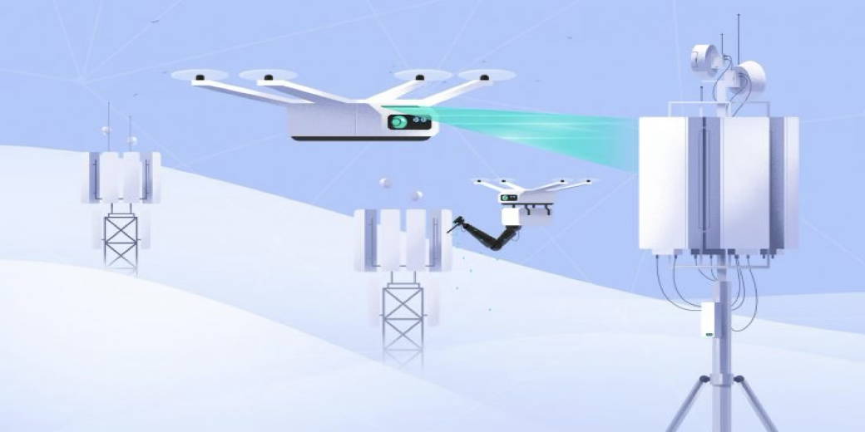
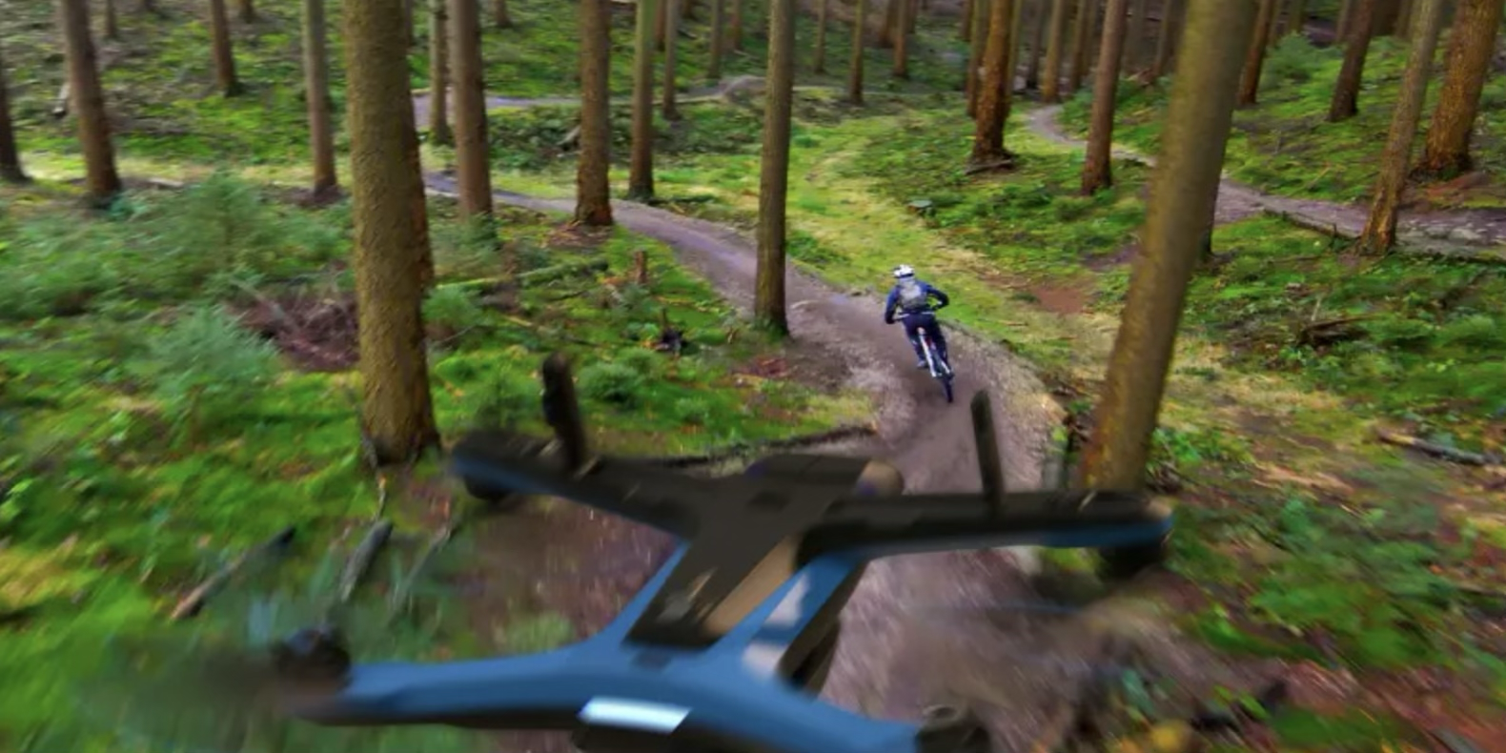
Robots That Adapts Continuously Across Tasks & Domains
Drone Delivery
Inspection & Maintenance
Target Tracking
Goal: Generate control inputs to achieve agile and accurate motion control across tasks & domains.^{1,2,3}
Challenges: Dynamics and/or disturbances that are unknown, difficult-to-model, adaptive:
Drone delivery: Packages with unknown weights.
Inspection and maintenance: Wind, drag, ground effects.
Target tracking: Targets with unknown dynamics.
¹ Ackerman, IEEE Spectrum '13
² Chen, Liu, Shen, IROS '16
³ Seneviratne, Dammika, et al., Acta Imeko '18

Slide 4
Model Predictive Control Under Uncertainty
All above scenarios are control problems under uncertainty
Goal: Find control input to minimize a look-ahead cumulative loss:
convex
known system dynamics
unknown uncertainty
control constraints

Slide 5
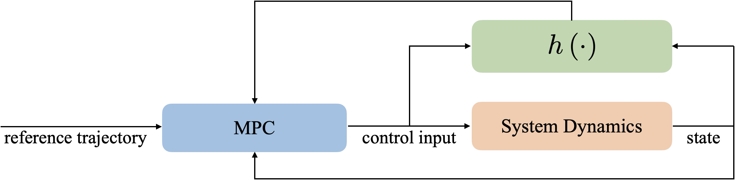
Model Predictive Control Under Uncertainty
All above scenarios are control problems under uncertainty
Goal: Find control input to minimize a look-ahead cumulative loss:
convex
known system dynamics
unknown uncertainty
control constraints
Ideally: if is known:

Slide 6
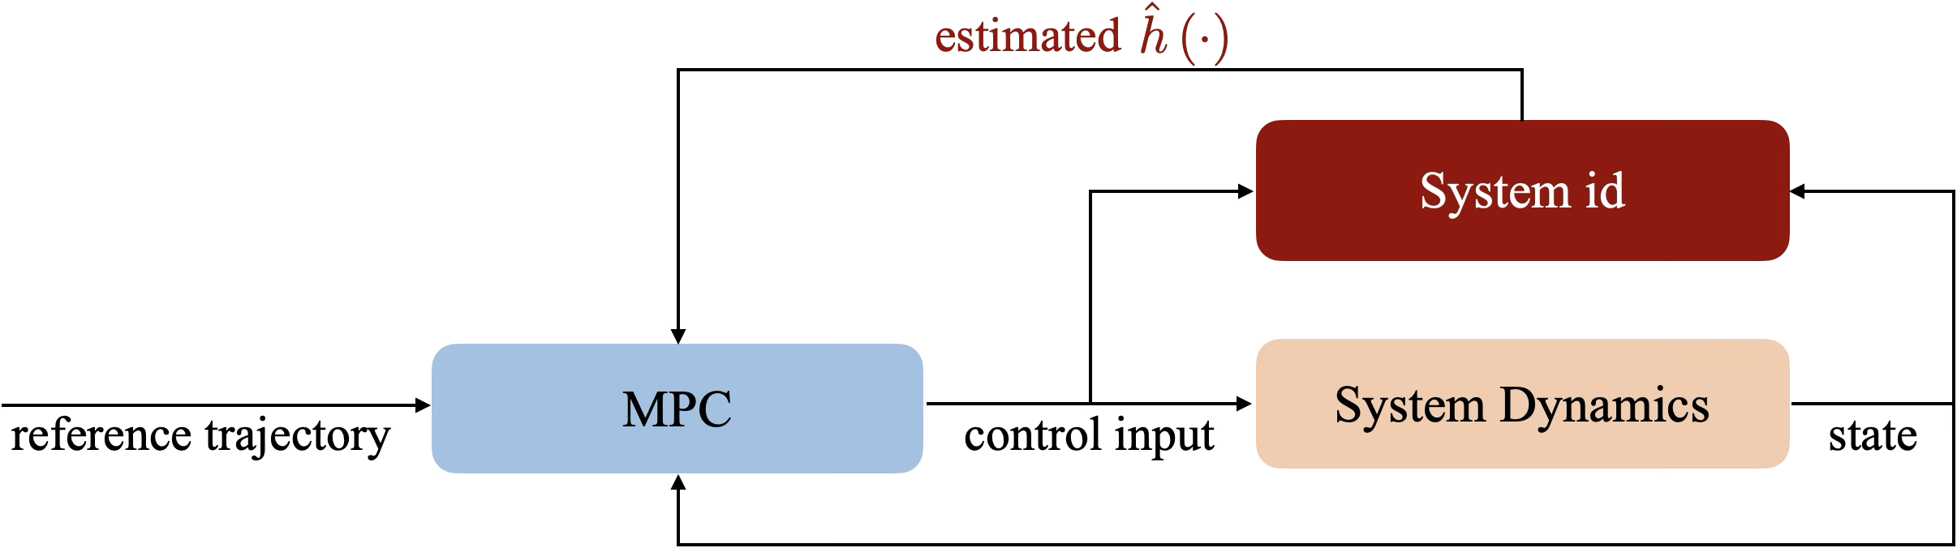
Model Predictive Control Under Uncertainty
All above scenarios are control problems under uncertainty
Goal: Find control input to minimize a look-ahead cumulative loss:
convex
known system dynamics
unknown uncertainty
control constraints
But is unknown:

Slide 7
System Identification given a Function Basis
Goal: Find online
Example:
Reproducing Kernels in Hilbert Spaces: Universal approximation theorem:⁴
[TRO '25]
Neural Networks: Similarly to above but where:
Koopman Observables:
[ACC '25]
⁴ Boffi et al, JMLR '22

Slide 8
System Identification given a Function Basis
Goal: Find online
Example:
Reproducing Kernels in Hilbert Spaces: Universal approximation theorem:⁴
[TRO '25]
Neural Networks: Similarly to above but where:
Koopman Observables:
[ACC '25]
⁴ Boffi, et al, JMLR '22

Slide 9

Simultaneous System Identification and Model Predictive Control
i.e., update estimate of

Slide 10
Suboptimality Metric against Optimal Control Policies in Hindsight

Slide 11
State of the Art
⁵
⁶
⁵ Sánchez-Sánchez et al., '18; Carron et al., RAL '19; Torrente et al., RAL '21; Shi et al., ICRA '19; O’Connell, et al., SR '22; …
⁶ Goel et al., '20; Sabag et al., ACC '21; Goel et al., L4DC '21; Martin et al., L4DC '22; Didier et al., L-CSS '22; Zhou et al., CDC '23; …

Slide 12
State of the Art
⁷
⁸
⁷ Slotine, '91; Krstic, et al., '95; Ioannou et al., '96; Tal et al., TCST '20; Wu, et al., '23; Das et al., '24; Jia, et al., TRO '23; …
⁸ Agarwal et al., ICML '19; Hazan et al., ALT '20; Gradu et al., L4DC '23; Zhou et al., CDC '23; Zhou et al., RAL '23; ...

Slide 13
Algorithm: Simultaneous Sys-ID and MPC

Slide 14
No Dynamic Regret
Theorem [TRO '25]

Slide 15
Assumptions
Definition (Value Function⁹)
⁹ Grimm, et al, TAC '05

Slide 16
Assumptions
Assumption (Stability Condition)
Assumption (Lipschitzness)
⁹ Grimm, et al, TAC '05

Slide 17
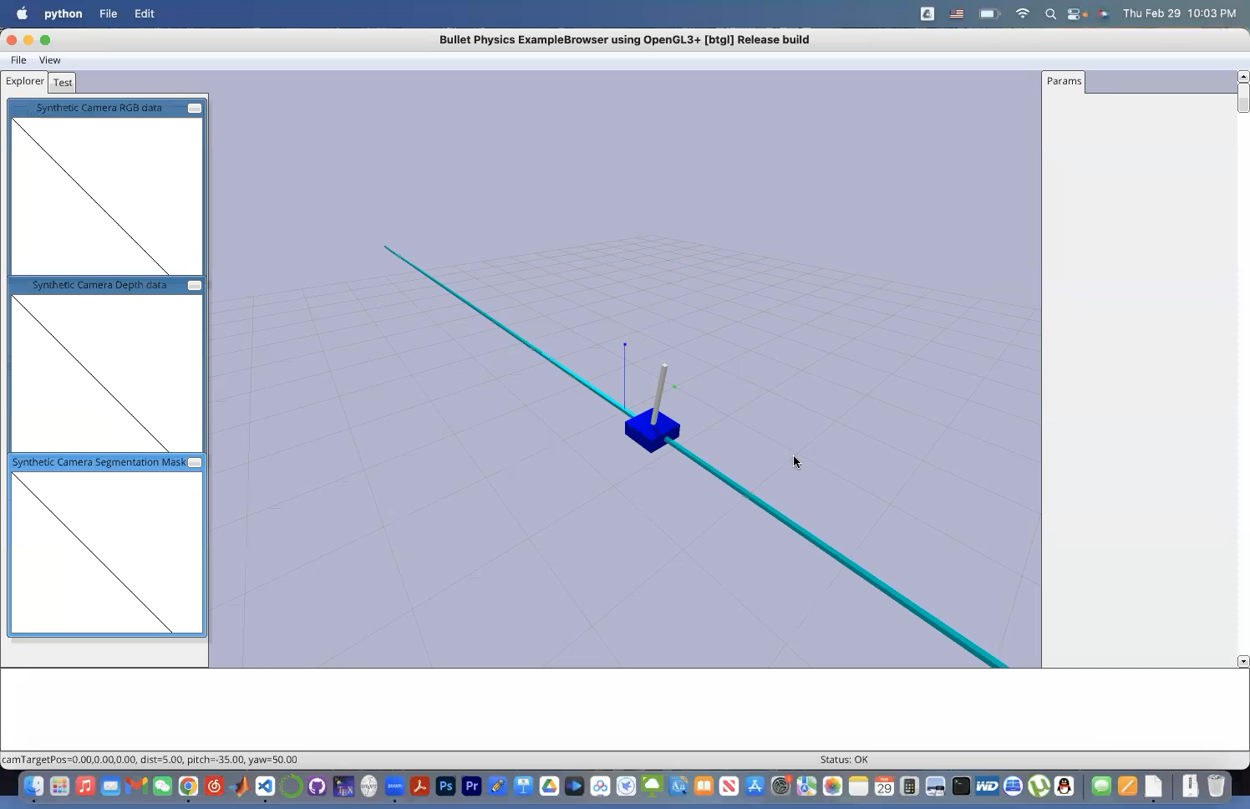


Simulations on Cart-Pole Stabilization with Inaccurate Model
Goal:
Stabilize the cart-pole around the upright position of the pole
Setup:
The model parameters (pole length & mass, cart mass) are inaccurate
Compared algorithms: (i) Non-stochastic MPC¹⁰ and (ii) Gaussian Process MPC¹¹
Ours
NS-MPC
GP-MPC
¹⁰ Zhou et al., RAL '23
¹¹ Hewing et al., TCST '19

Slide 18
Our Algorithm Achieves Fastest Stabilization
Results:
Our method achieves fastest stabilization while other algorithms:
NS-MPC has marginal improvement over Nominal MPC
GP-MPC has larger deviation than our method

Slide 19
Simulations on Cart-Pole Stabilization with Inaccurate Model
Results:
Our method is computationally more efficient than GP-MPC

Slide 20
Simulations on Cart-Pole Stabilization with Inaccurate Model
Results:
Prediction error decreases as we collect more data

Slide 21
Simulations on Trajectory Tracking with Unknown Aerodynamic Effect
Goal:
Track reference trajectories with a drone
Setup:
The system dynamics of the drone are corrupted with unknown drag effects

Slide 22
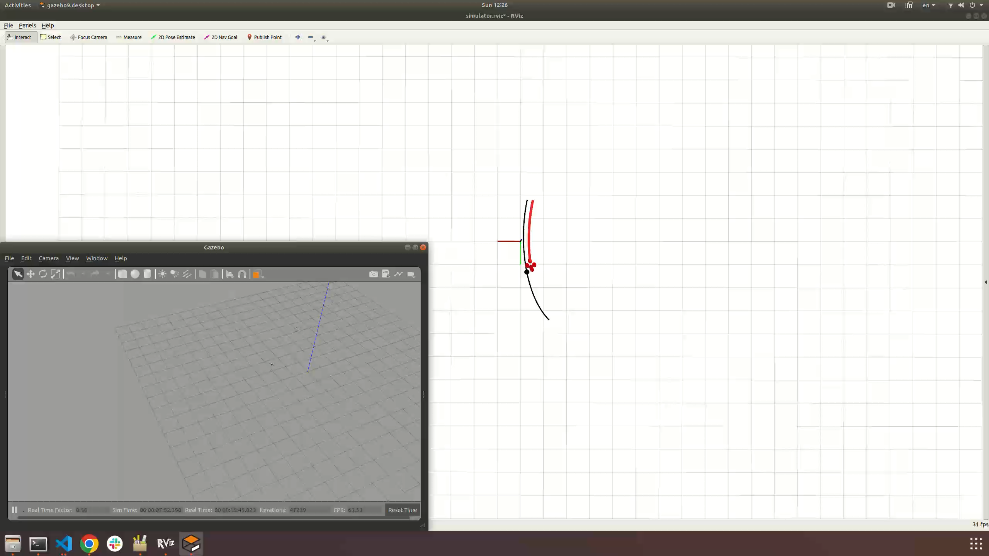

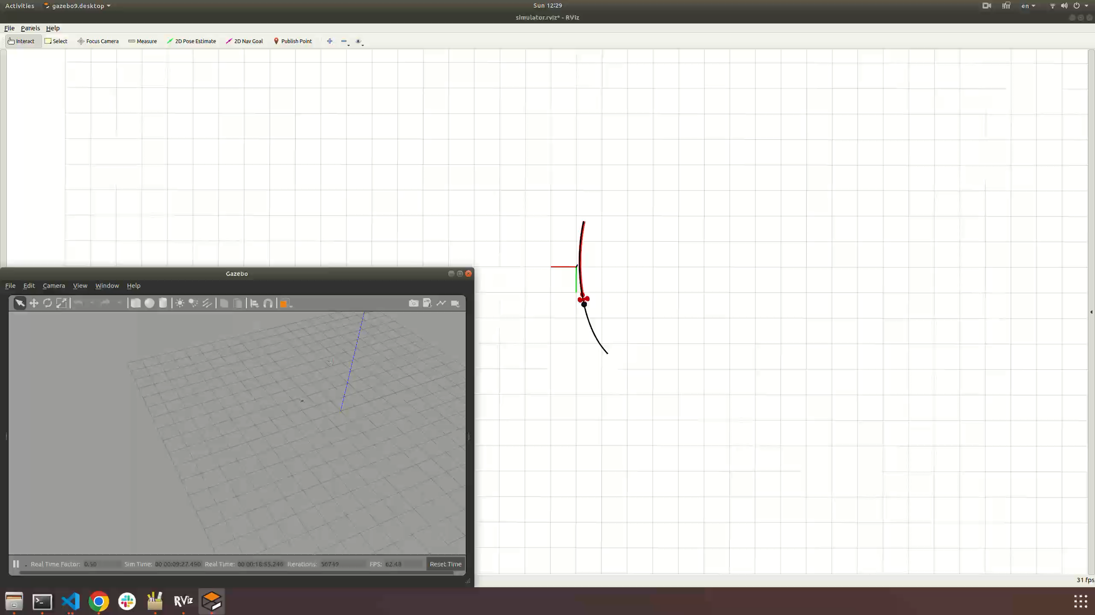
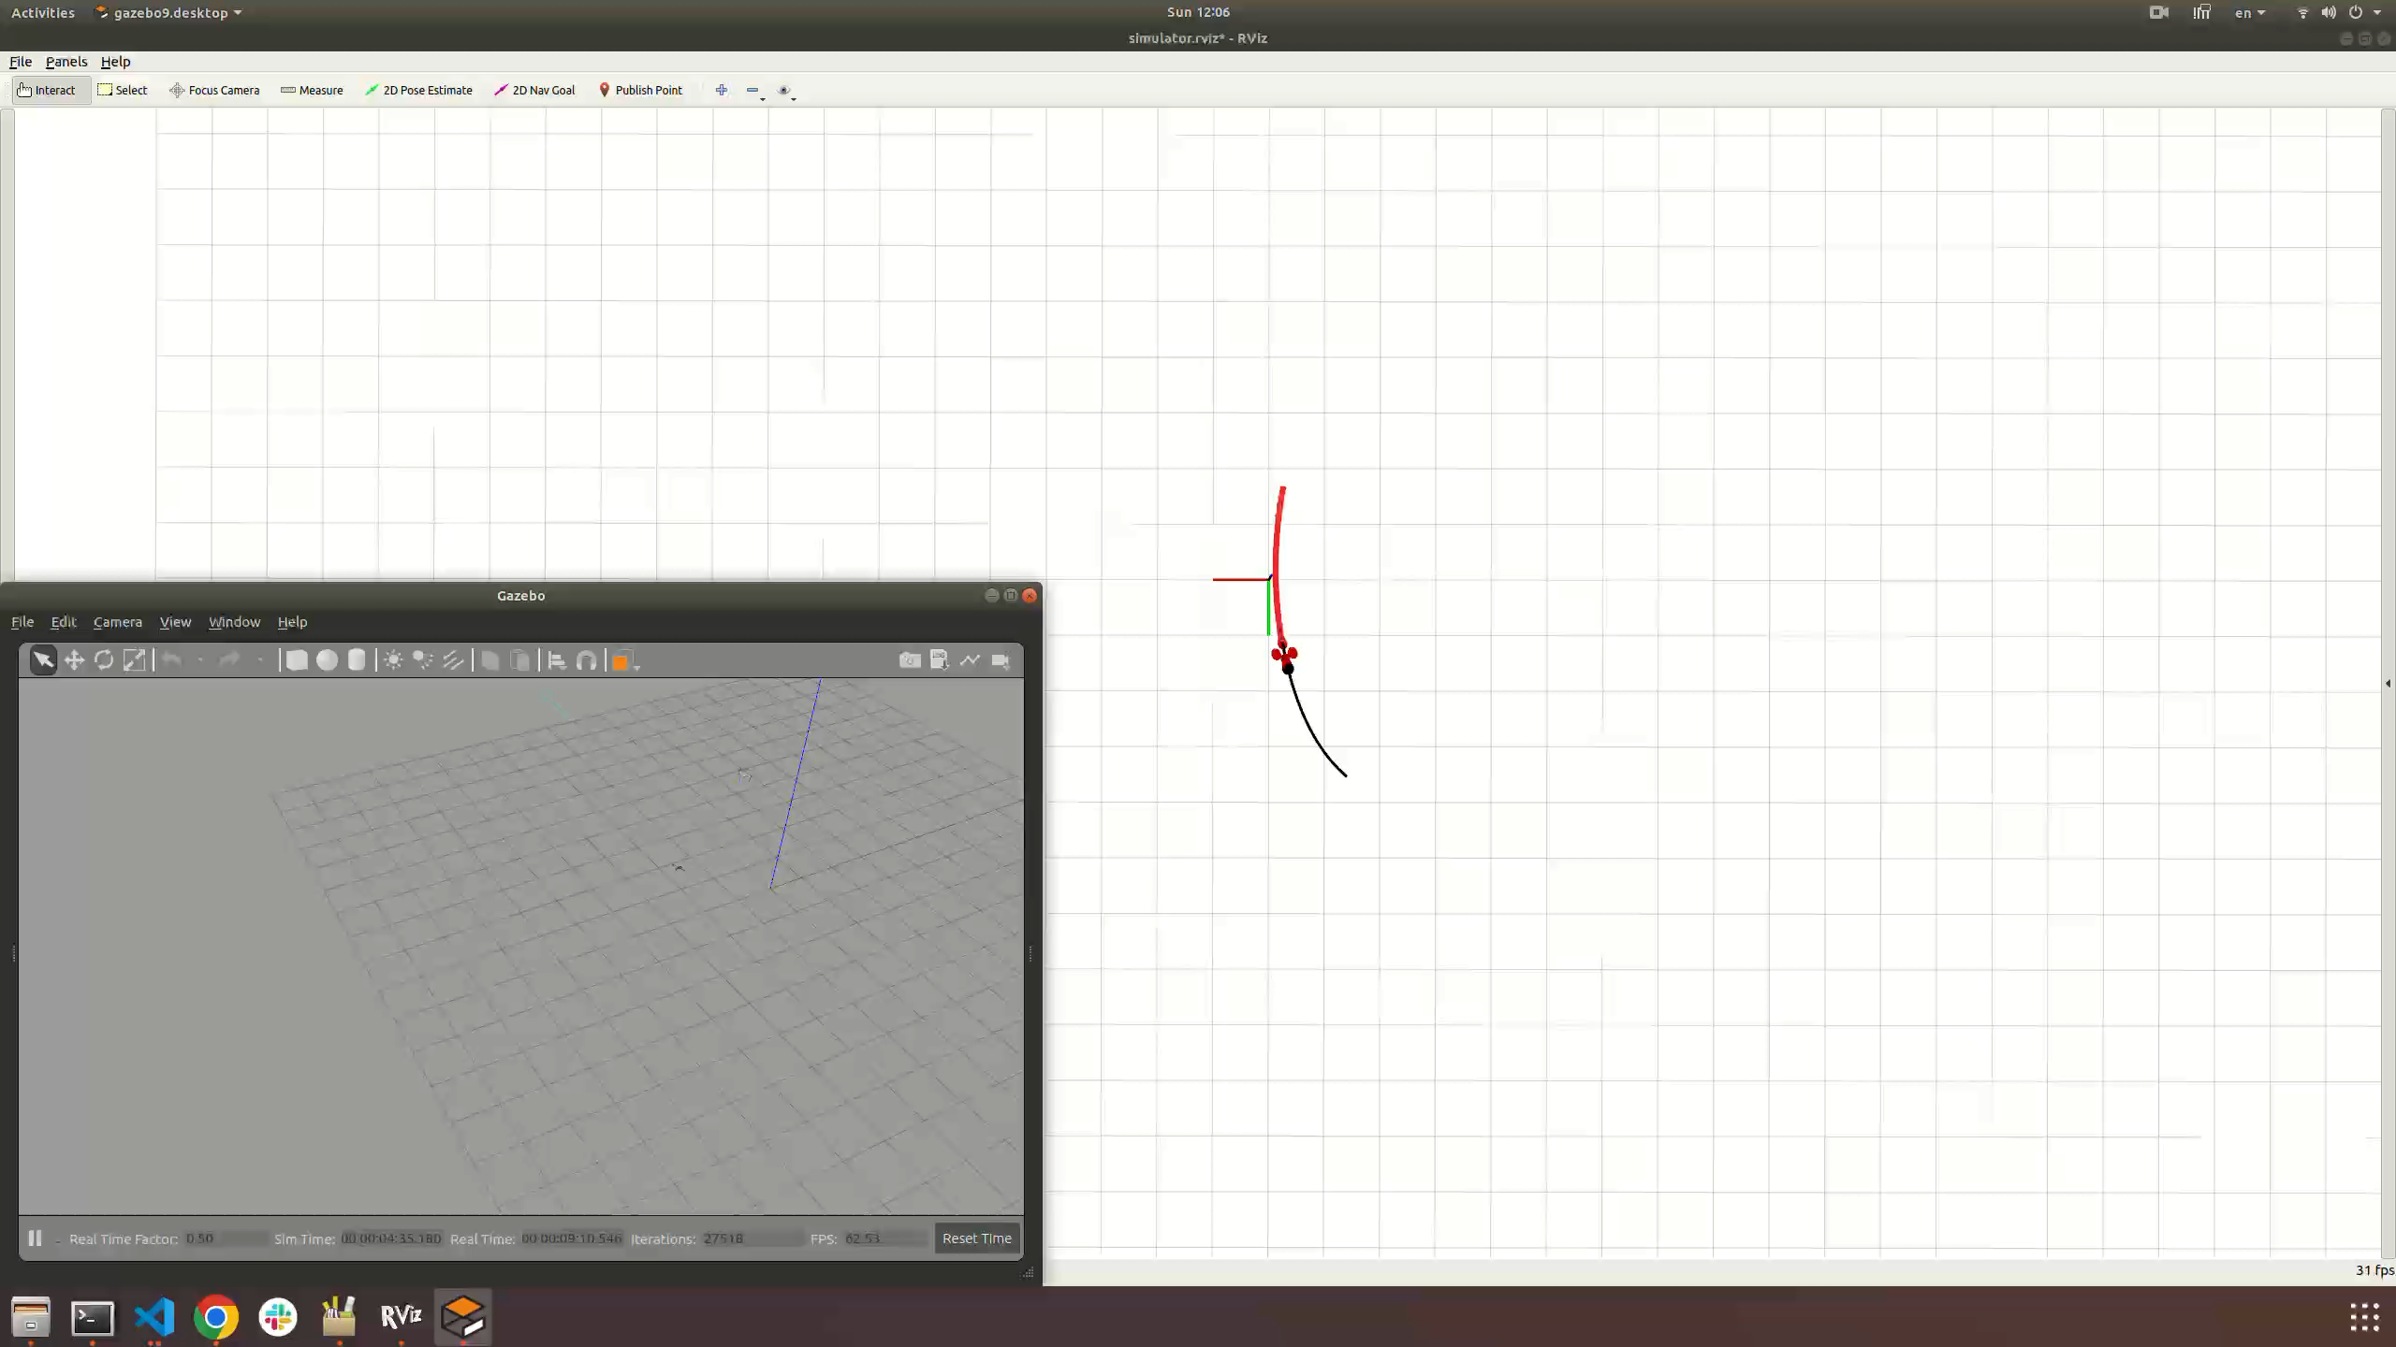
Simulations on Trajectory Tracking with Unknown Aerodynamic Effect
Goal:
Track reference trajectories with a drone
Setup:
The system dynamics of the drone are corrupted with unknown drag effects
Compared algorithms: (i) Nominal MPC, (ii) Gaussian Process MPC¹², and (iii) Ours w/ INDI inner loop¹³
Nominal MPC
GP-MPC
Ours
Ours w/ INDI
¹² Torrente et al., RAL '21
¹³ Tal et al., TCST '20

Slide 23
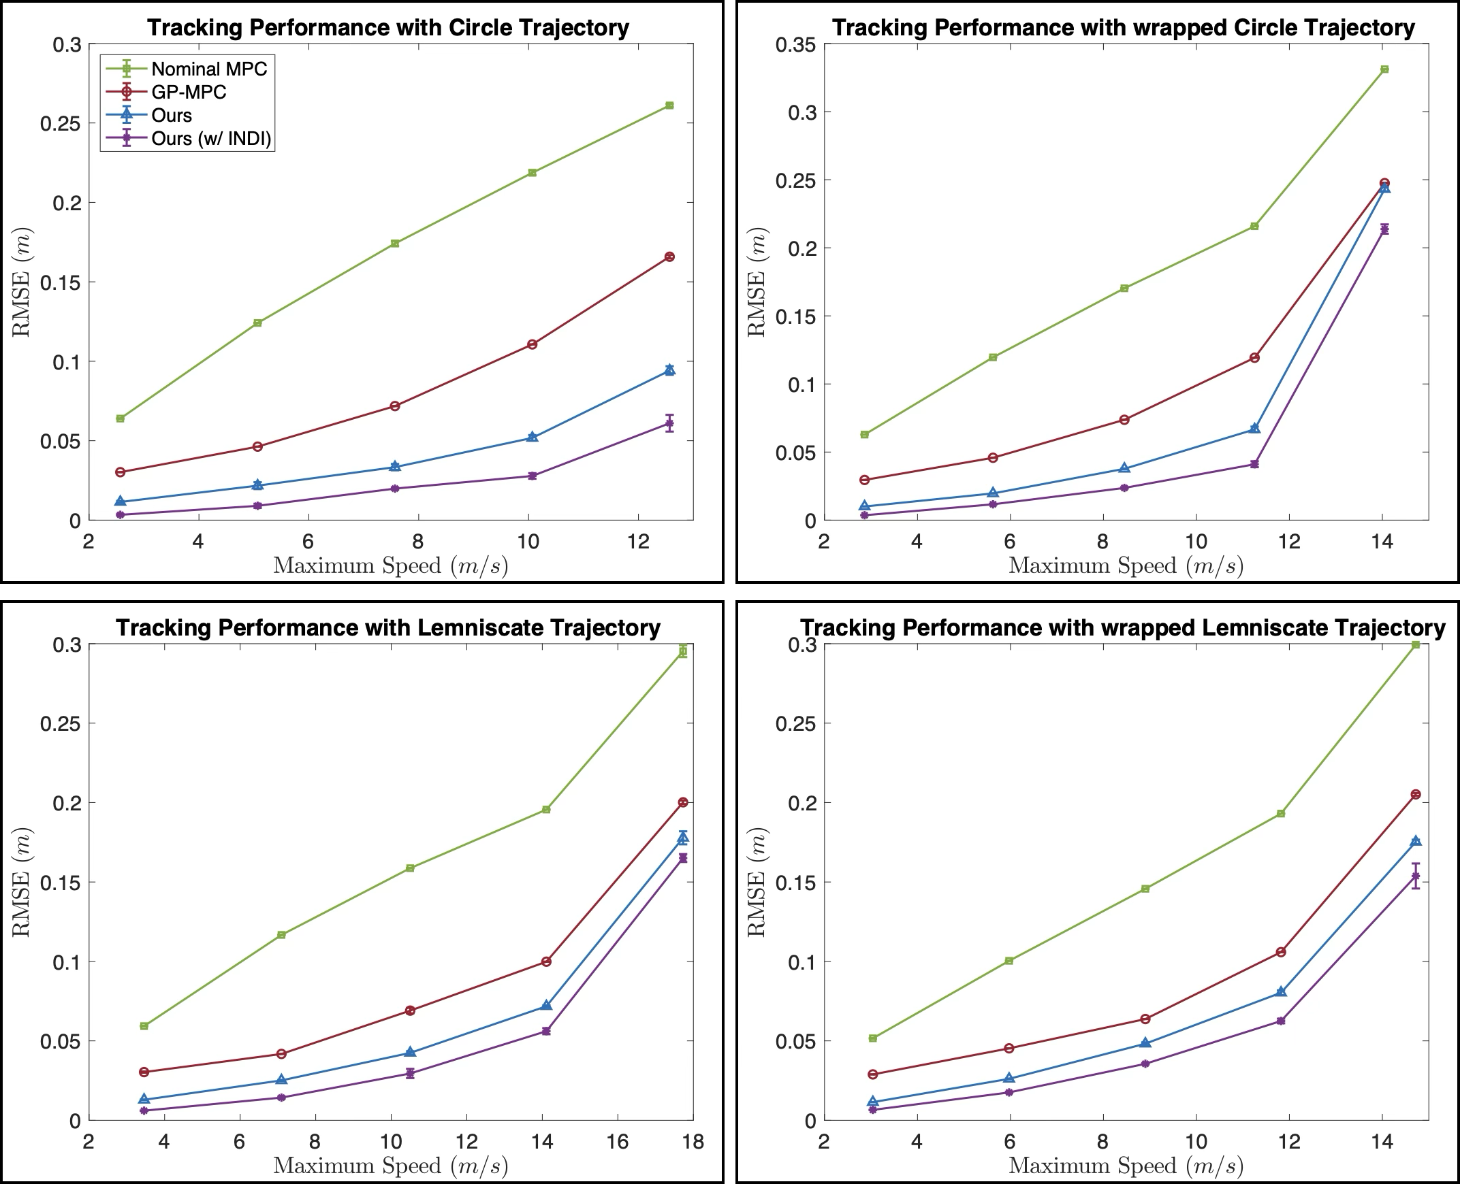
Our Algorithm Achieves Lowest Tracking Errors

Slide 24
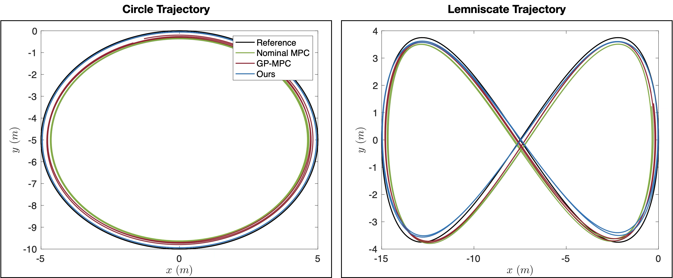
Sample Trajectory w/ Maximun Speed > 10m/s
Results:
Ours achieves lower tracking errors than GP-MPC

Slide 25
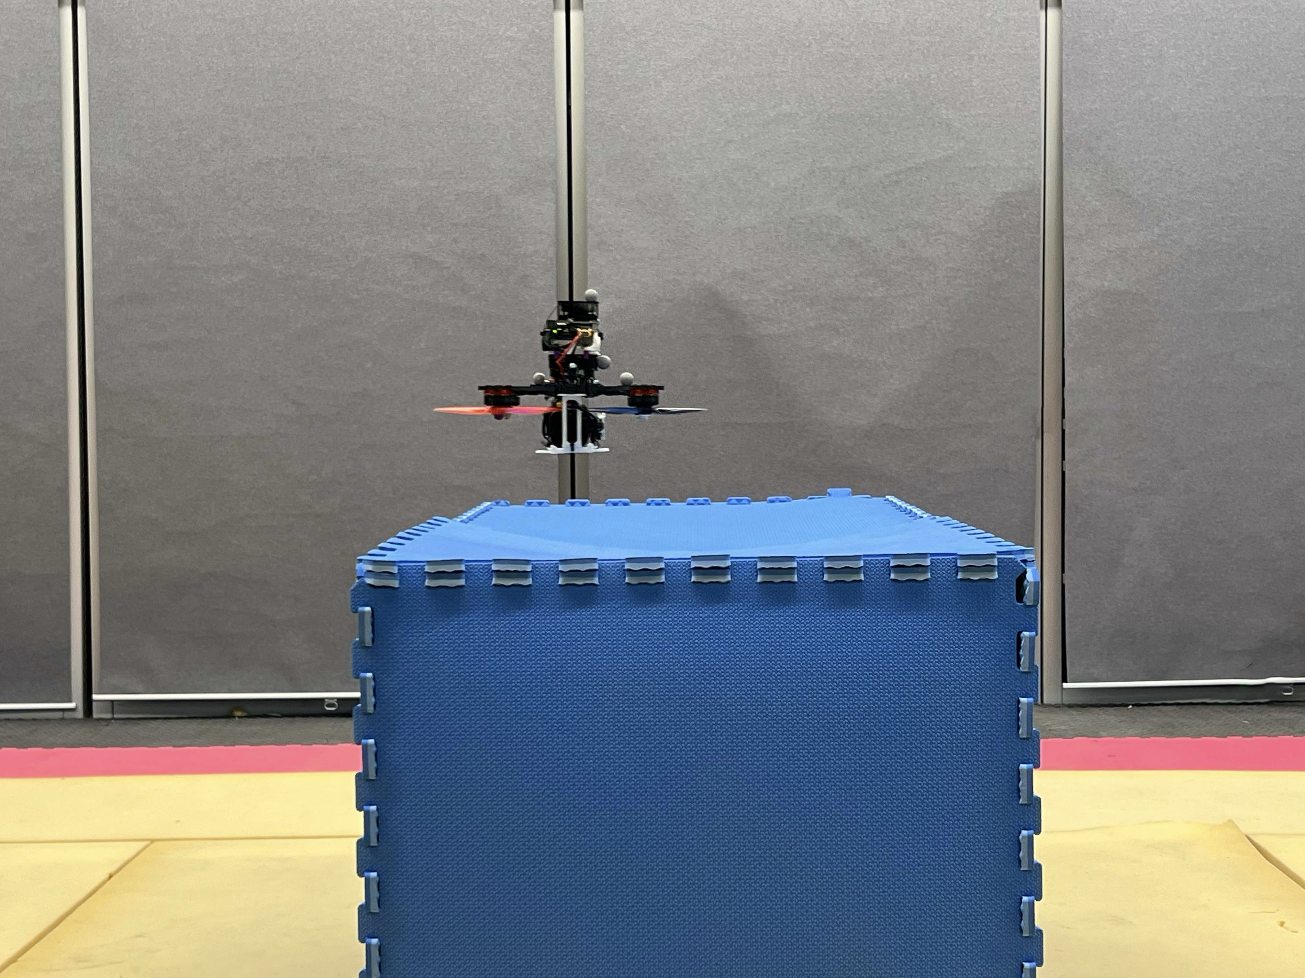
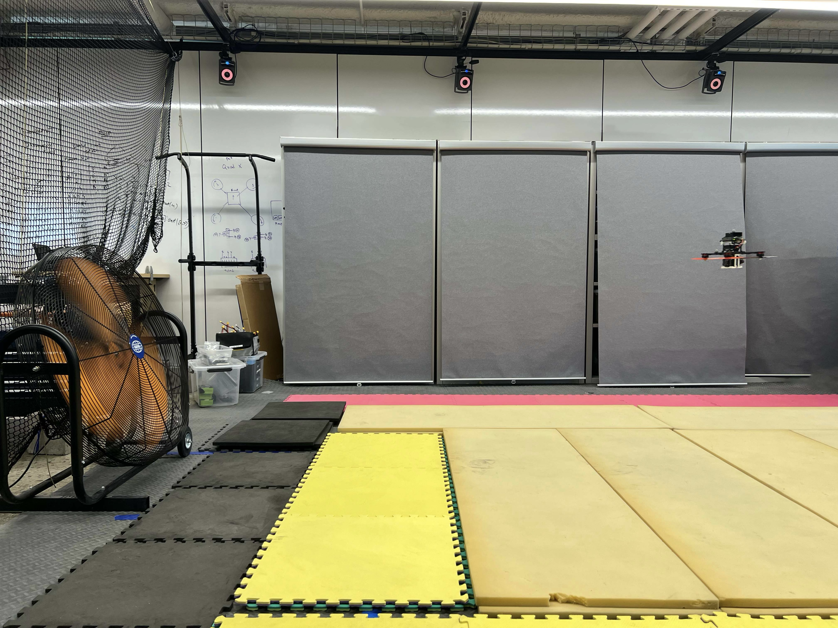
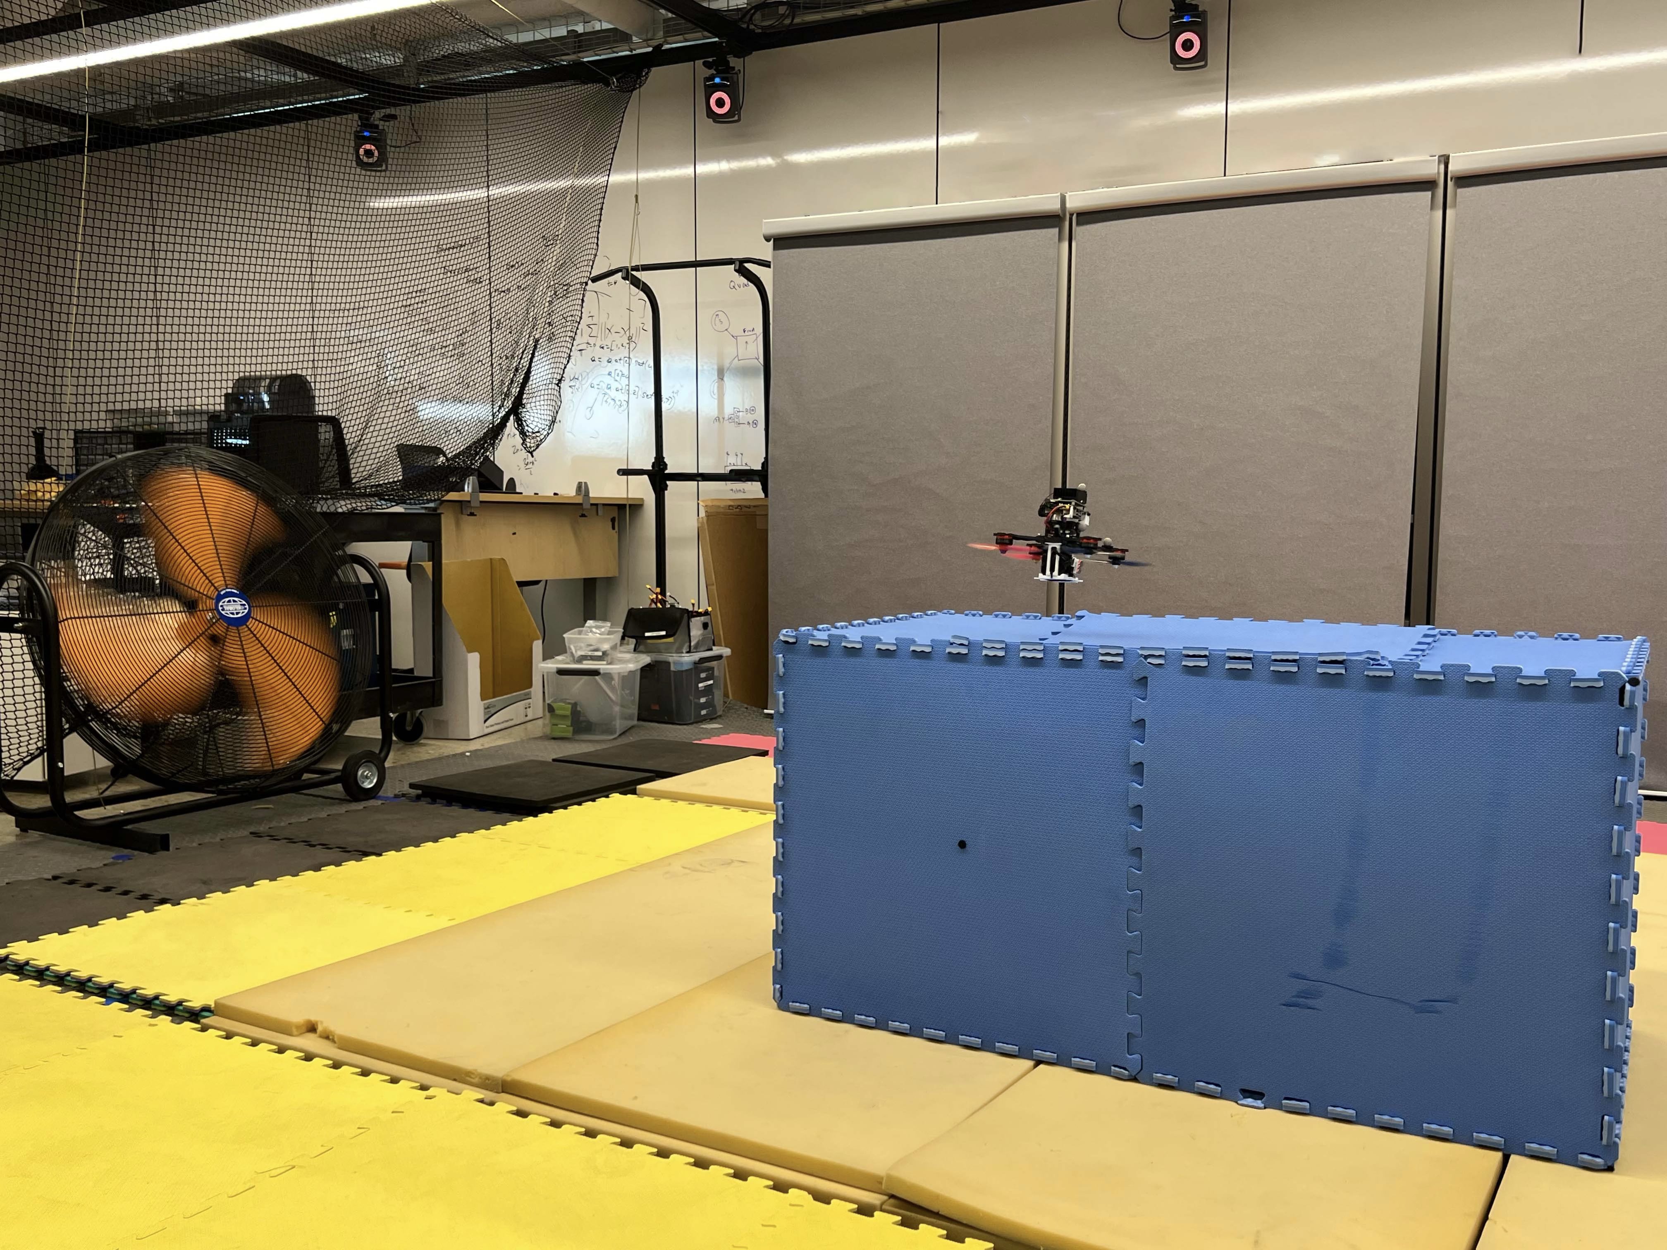
Hardware on Trajectory Tracking with Unknown Aerodynamic Effect
Goal:
Track a circular trajectory with a drone
Setup:
The circular trajectory is 1m in diameter
The speed is 0.8 m/s
The drone suffers from drag, voltage drop, communication delay, and:
(i) ground effect
(ii) wind disturbances
(iii) ground effect + wind disturbances

Slide 26
Hardware on Trajectory Tracking with Unknown Aerodynamic Effect
Goal:
Track a circular trajectory with a drone
Setup:
The circular trajectory is 1m in diameter
The speed is 0.8 m/s
The drone suffers from drag, voltage drop, communication delay, and (i) ground effect, (ii) wind disturbances, and (iii) ground effect + wind disturbances
Compared algorithms: (i) Nominal MPC and (ii) L1 adaptive MPC¹⁴
¹⁴ Wu et al., TCST '25

Slide 27
Our Algorithm Achieves Lowest Tracking Errors
Results:
Nominal MPC crashes under ground effect & wind disturbances
Ours achieves lower tracking errors than L1-MPC, due to the benefit of predictive model of unknown disturbances

Slide 28
Sample Trajectory with Ground Effect
Results:
Ours achieves lowest tracking errors
L1-MPC do not learn the disturbance model and has large error when the disturbances change abruptly
Nominal MPC has poor z-direction tracking error due to ground effect and battery’s voltage drop

Slide 29
Sample Trajectory with Wind Disturbances
Results:
Ours achieves lowest tracking errors
Nominal MPC has poor z-direction tracking error due to ground effect and battery’s voltage drop

Slide 30
Sample Trajectory with Ground Effect & Wind Disturbances
Results:
Ours achieves lowest tracking errors
Nominal MPC crashes under ground effect & wind disturbances

Slide 31
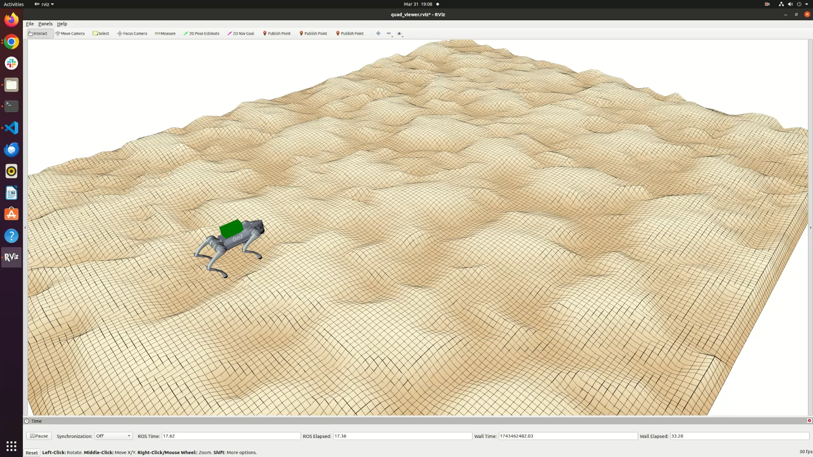
Summary & Extension
Online control algorithm for partially unknown control-affine systems with:
simultaneous system identification and model predictive control
no-dynamic-regret performance guarantees
Extension:
Hybrid systems
Active learning
Uncertainty quantification

